Slide 1

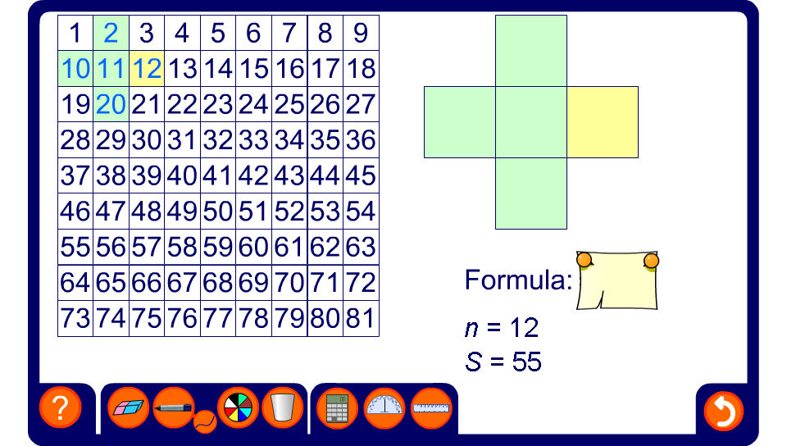


Number grid patterns
Notes:
Discuss how each number in the pattern can be written in terms of one of the numbers. Ask pupils to five formulae for various arrangements and discuss any patterns that pupils notice.

